Slide 1

Development of an Automated Task Sequencing Framework
Cherif Ghazi
Supervised by Felix Wang
25. April 2022, Zurich

Slide 2
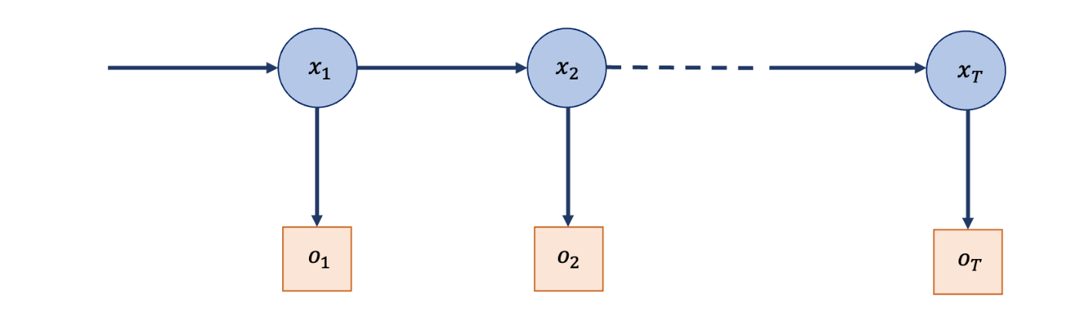
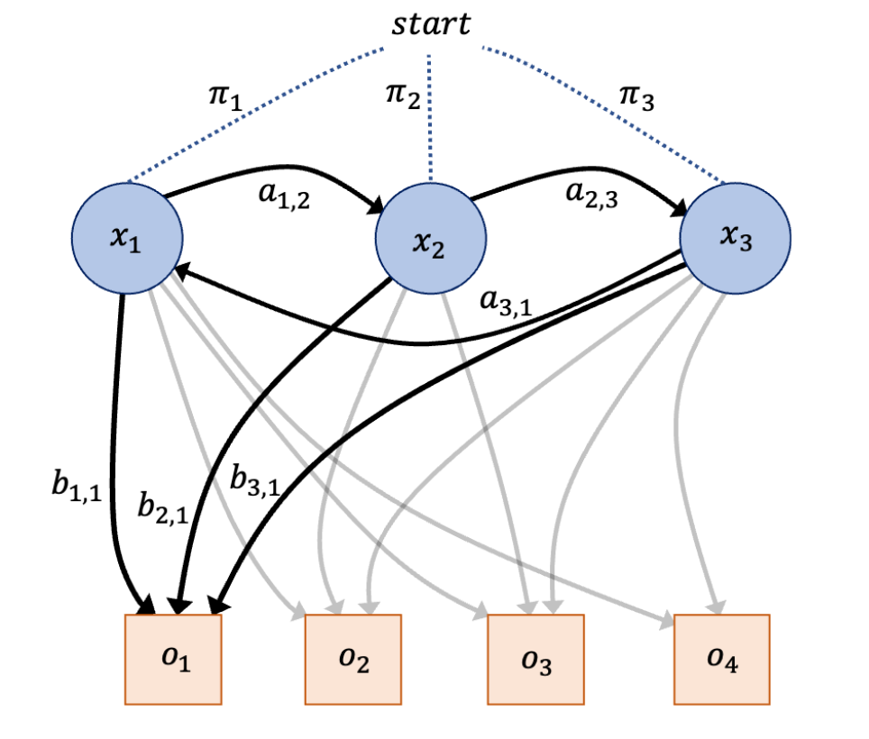
Introduction Introduction | MTL | Supervised vs Unsupervised | Results | Mediapipe | New Algorithm | Metrics | Conclusion | Bibliography
How the model works now.
Prediction based on previous and current state and an ensemble of probabilities.

Slide 3
Example Data Introduction | MTL | Supervised vs Unsupervised | Results | Mediapipe | New Algorithm | Metrics | Conclusion | Bibliography
Cap Off - Removal of the pen cap.
Significant Area of interest ( AOI ): Cap, Pen
Apply Tip - Applying the disposable needle to the pen.
Significant AOIs: Safety, Tip, Pen
Setting Units - Setting or checking the desired number of units using the dosage knob. Significant AOIs: Gauge
Priming-Testing the function of the needle, removing trapped air by holding the device upright and releasing 1-2 units. Significant AOIs: Tip, Pen, App
Injection - Placing the needle into injection area, injecting 5-10 units for 10 seconds.
Significant AOIs: Pad, Tip, App
Remove Tip - Removal of the disposable needle from the pen.
Significant AOIs: Safety, Tip, Pen
Cap On - Applying the Cap to the Pen.
Significant AOIs: Cap, Pen
Start_time | End_time | App | Cap | Gauge | Pen | Safety | Tip | Action
0 | 0.5 | 400 | 111 | 0 | 380 | 1600 | 0 | Apply Tip
0.5 | 1 | 417 | 85 | 87 | 480 | 1600 | 1600 | Apply Tip
1.5 | 2 | 300 | 84 | 1600 | 515 | 1600 | 500 | Setting Units
2 | 2.5 | 200 | 1 | 1600 | 600 | 1600 | 200 | Apply Tip
Experiments have been carried out on several participants.
They had to perform 7 different action.

Slide 4
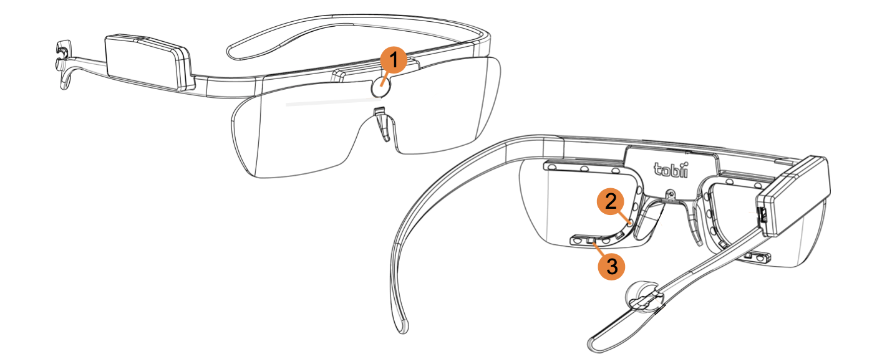
Tobi Pro Glasses 2 Introduction | MTL | Supervised vs Unsupervised | Results | Mediapipe | New Algorithm | Metrics | Conclusion | Bibliography
High- definition scene camera - Captures a Full HD video of what is in front of the participant.
IR illuminators - Illuminates the eyes to support the eye tracking sensors.
Eye tracking sensors - Records eye orientation e.g. the direction of the eye gaze
(Tobii AB 2018).

Slide 5
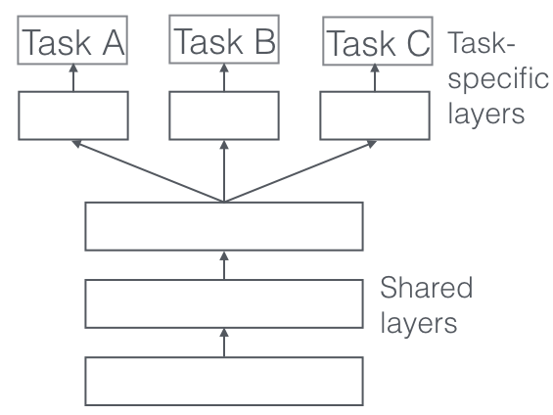
Multi Task Learning ( MTL ) Introduction | MTL | Supervised vs Unsupervised | Results | Mediapipe | New Algorithm | Metrics | Conclusion | Bibliography
Initial Idea.
Sharing representations between
related tasks.

Slide 6
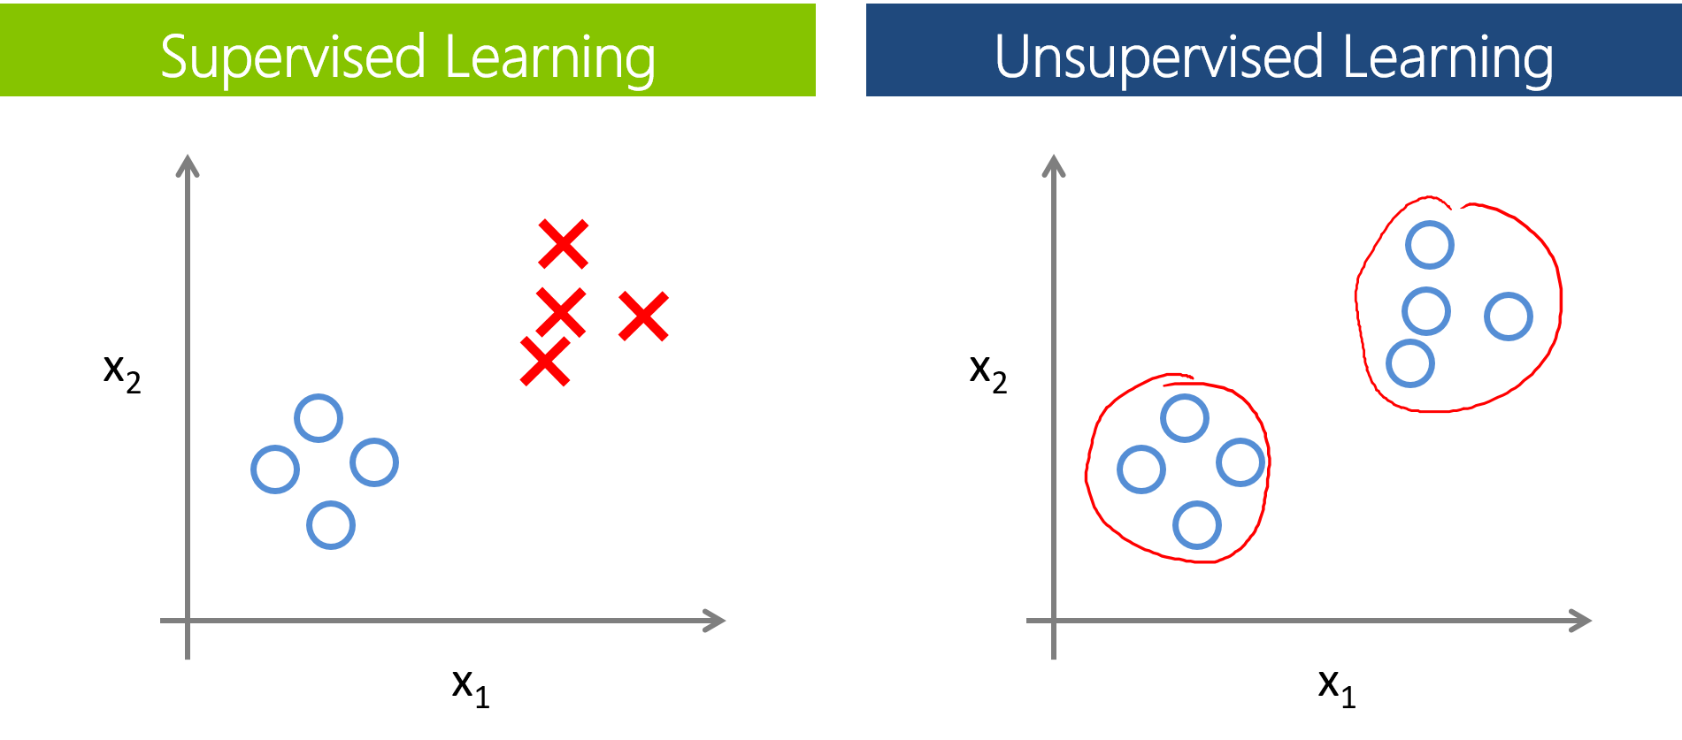
Supervised VS Unsupervised learning Introduction | MTL | Supervised vs Unsupervised | Results | Mediapipe | New Algorithm | Metrics | Conclusion | Bibliography
Different approaches.
Clustering the data using
Kmeans.
Raw data as an input to
a Neural Network (NN).

Slide 7
Advantages and Disadvantages Introduction | MTL | Supervised vs Unsupervised | Results | Mediapipe | New Algorithm | Metrics | Conclusion | Bibliography
Advantages
Disadvantage
Easy to find how many classes are there before giving data for training
Very efficient once it has been properly trained
Needs a lot of computer resources
Risk of overfitting
Supervised
Learning
Does not need as much computer resources
No risk of overfitting
Need to interpret the optimal number of clusters
It is not always certain that the obtained results will be useful since there is no label or output measure to confirm its usefulness.
Unsupervised
Learning

Slide 8
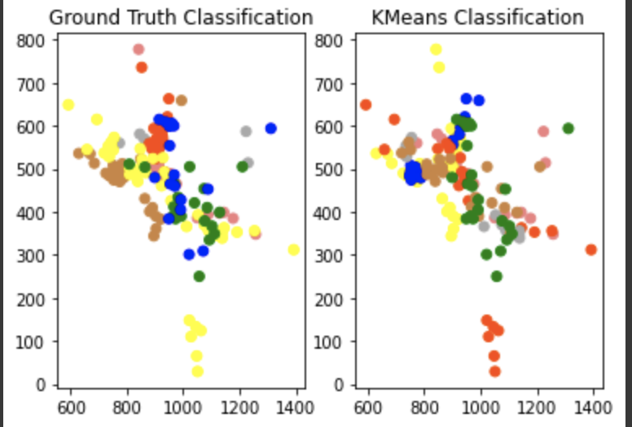
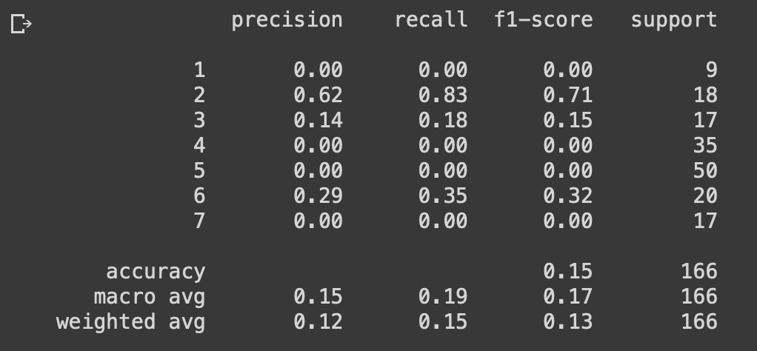
Unsupervised Learning Results Introduction | MTL | Supervised vs Unsupervised | Results | Mediapipe | New Algorithm | Metrics | Conclusion | Bibliography
Low accuracy (15%) probably due to high dimensionality ( 7 dimensional data ).
We had to find a new solution / approach.

Slide 9
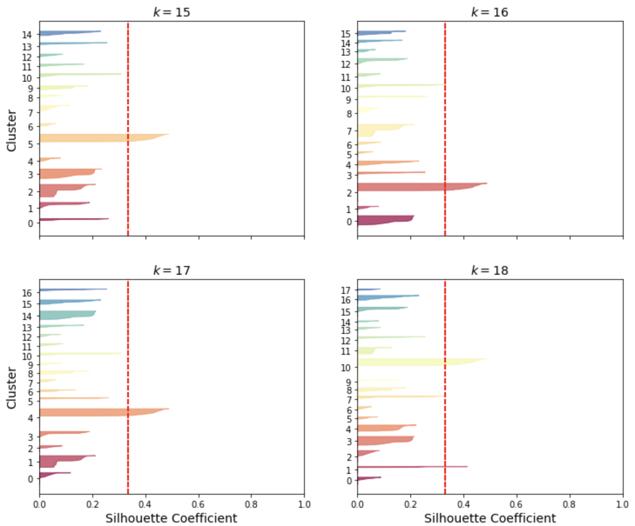
Silhouette Coefficients Introduction | MTL | Supervised vs Unsupervised | Results | Mediapipe | New Algorithm | Metrics | Conclusion | Bibliography
Method of interpretation and validation of consistency within clusters of data
How similar an object is to its own cluster compared to other clusters
Ranges from -1 to +1
High value indicates that the object is well matched to its own cluster
Low value means clustering configuration may have too many or too few clusters

Slide 10
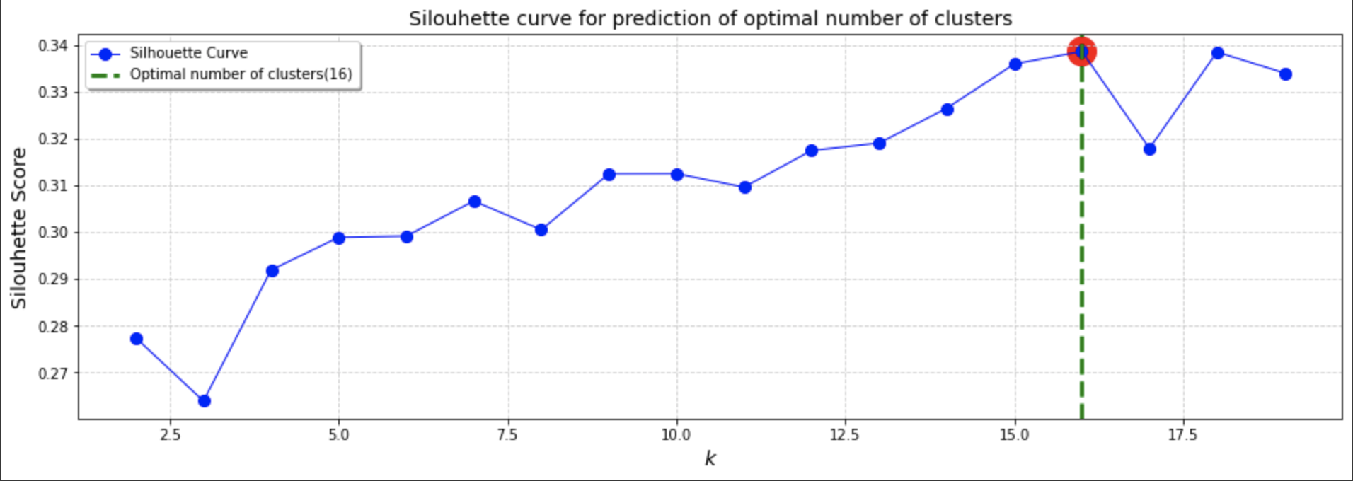
Silhouette Coefficients Introduction | MTL | Supervised vs Unsupervised | Results | Mediapipe | New Algorithm | Metrics | Conclusion | Bibliography
Method of interpretation and validation of consistency within clusters of data.
Provides a succint graphical representation of how well each object has been classified.

Slide 11
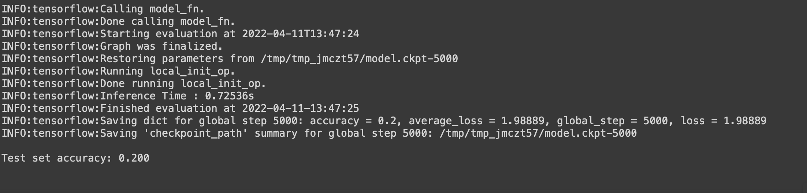
Supervised Learning Results Introduction | MTL | Supervised vs Unsupervised | Results | Mediapipe | New Algorithm | Metrics | Conclusion | Bibliography
Low accuracy (20%) .
Layers 100-80-50-20

Slide 12
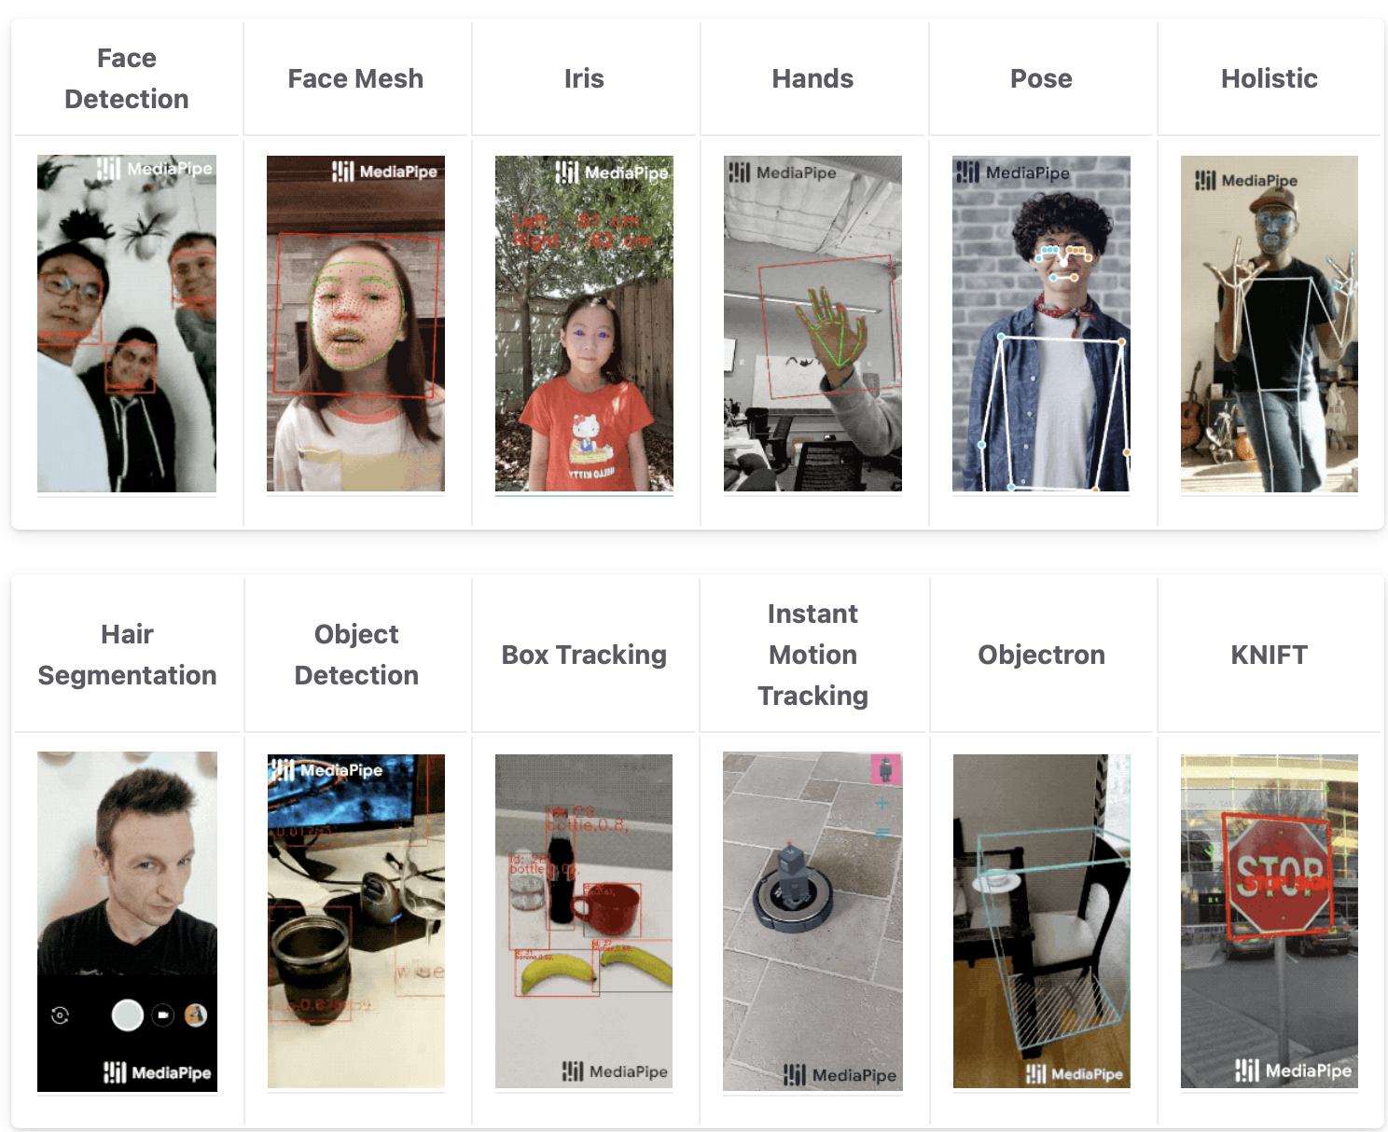
Mediapipe Introduction | MTL | Supervised vs Unsupervised | Results | Mediapipe | New Algorithm | Metrics | Conclusion | Bibliography
Google Model.
Trained over a million images.

Slide 13
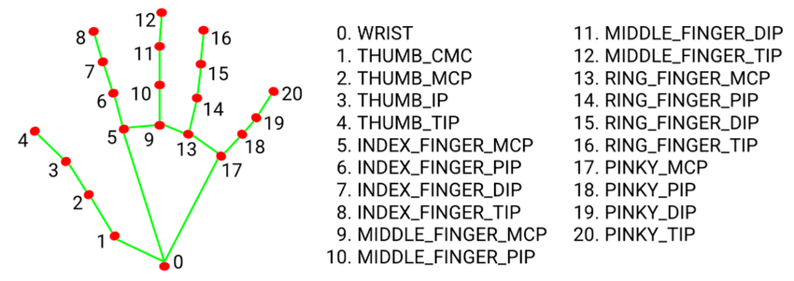
Landmarks Introduction | MTL | Supervised vs Unsupervised | Results | Mediapipe | New Algorithm | Metrics | Conclusion | Bibliography
Detecting a bunch of landmarks on the hands.
Classified and identified.

Slide 14

Unsupervised Learning Results Introduction | MTL | Supervised vs Unsupervised | Results | Mediapipe | New Algorithm | Metrics | Conclusion | Bibliography
Prints all the landmarks on the video.
Detecting whether the hand is left or right.
Ouputs x and y coordinates of the different landmarks in the image frame.

Slide 15
What we can achieve Introduction | MTL | Supervised vs Unsupervised | Results | Mediapipe | New Algorithm | Metrics | Conclusion | Bibliography
Prints all the landmarks on the video.
Detecting whether the hand is left or right.
Ouputs x and y coordinates of the different landmarks in the image frame.
Origin of the frame

Slide 16
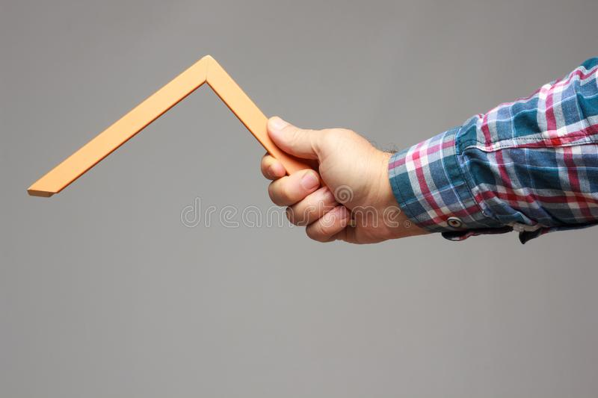
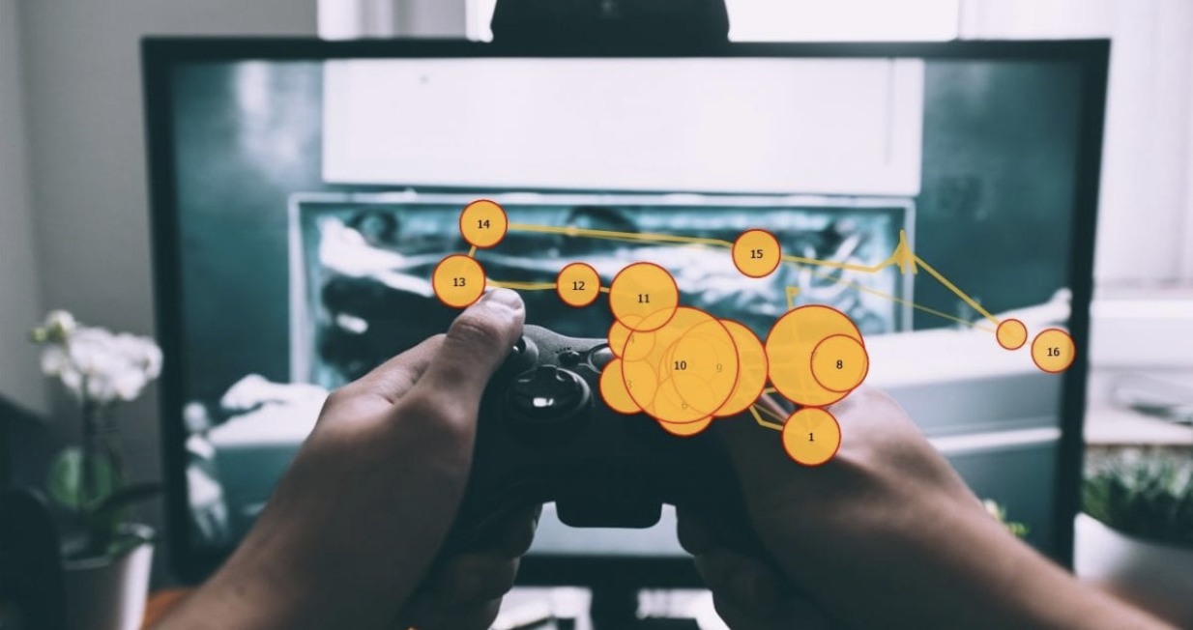
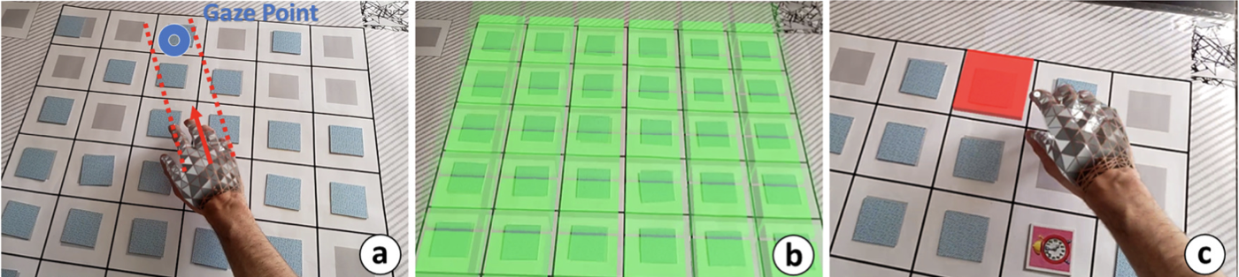
Metrics Introduction | MTL | Supervised vs Unsupervised | Results | Mediapipe | New Algorithm | Metrics | Conclusion | Bibliography
Hand Object Gaze Object Gaze Hand

Slide 17
Conclusion Introduction | MTL | Supervised vs Unsupervised | Results | Mediapipe | New Algorithm | Metrics | Conclusion | Bibliography
Future
Continue to focus on two approaches.
Dig unsupervised learning deeper.
Improve former algorithm based on Hidden Markov models or come up with a new neural Network if we do not succeed in improving it.
Possible issues
Synchronization between algorithm ( 15 Hz ) and glasses ( 25 Hz )
Understanding clusters
Combine the data and hand tracking

Slide 18
Bibliography Introduction | MTL | Supervised vs Unsupervised | Results | Mediapipe | New Algorithm | Metrics | Conclusion | Bibliography
https://ruder.io/multi-task/index.html#fn3
https://lakshaysuri.wordpress.com/2017/03/19/machine-learning-supervised-vs-unsupervised-learning/
https://fr.wikipedia.org/wiki/Silhouette_(clustering)
https://google.github.io/mediapipe/
https://imotions.com/blog/10-terms-metrics-eye-tracking/
Gaze Comes in Handy: Predicting and Preventing Erroneous Hand Actions in AR-Supported Manual Tasks , Julian Wolf
https://www.dreamstime.com/object-form-geometric-part-angle-degrees-expert-hand-professional-to-take-measurements-calculate-right-image168287546
Development of a Peripheral Vision Based Approach to Human Task Classification, Thomas Kreiner

Slide 19
Felix Wang
Phd Student
wangfe@ethz.ch
ETH Zürich
Product Development Group
LEE O10
Leonhardstrasse 21
8092 Zürich
Footer
24.04.22
Slide 19

